Slide 1

HACKTJ
Motive AR
Reclaiming Motion Through Augmented Reality
Transforming stroke rehabilitation with adaptive visual therapy
Avi A & Ekansh A
Notes:
"Picture this: half of all stroke survivors lose awareness of an entire side of their world. That's millions of people struggling with daily tasks we take for granted. Today, we're introducing Motive AR, an augmented reality solution that forces recovery of hemispatial neglect."

Slide 2



A Hidden Crisis
Stroke Survivors
Right Hemisphere Stroke
50%
80%
experience spatial neglect
show unilateral spatial neglect
Tandfonline, 2025
NCBI, 2021
Overall Incidence
38%
These patients struggle with daily activities, face increased fall risks, and experience delayed recovery without targeted visual rehabilitation.
visuospatial neglect post-stroke
AHA Journals, 2025
Notes:
This is a hidden crisis. According to research published in Tandfonline in 2025, 50% of stroke survivors experience spatial neglect. Even more alarming: patients with right hemisphere damage? Up to 80% show unilateral neglect, according to NCBI data from 2021. And the overall incidence across all strokes? 38%, reported by AHA Journals just this year. These patients can't eat, dress, or navigate safely without help. Traditional therapy? Limited at best. We need something better.

Slide 3
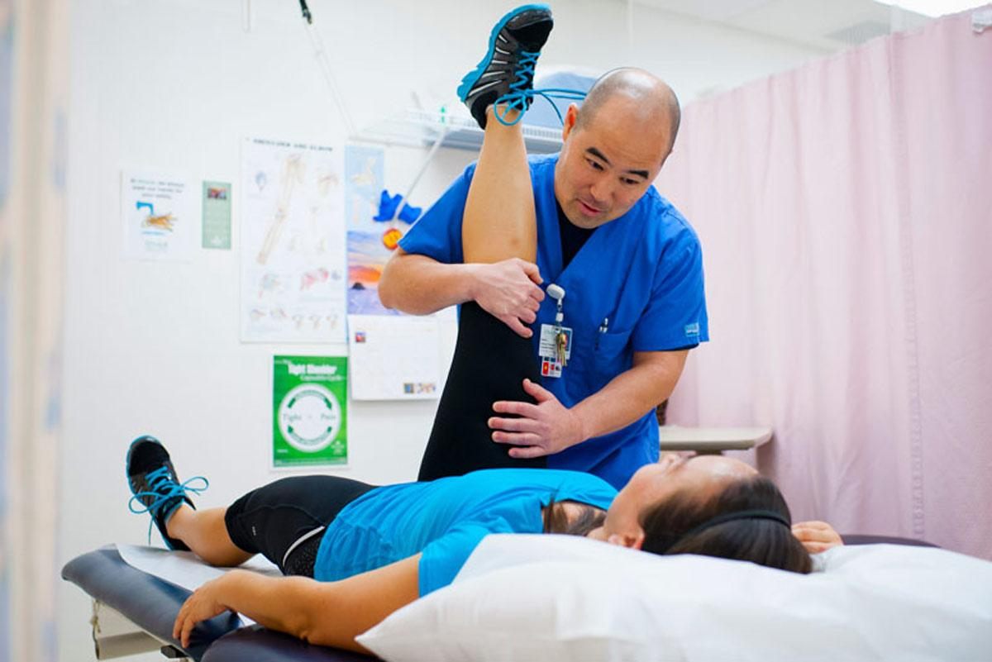



Introducing Motive AR
INNOVATIVE THERAPY
Adaptive Visual Therapy System
AR-powered rehabilitation that forces engagement and accelerates recovery
Peripheral Shrouding
AR spectacles modify visual perception in real-time
Forced Action Therapy
Patients actively engage to restore motion
Neuroscience-backed approach to visual attention rehabilitation
Notes:
"Enter Motive AR. We've built an adaptive visual therapy system using augmented reality spectacles that does two revolutionary things. First, Peripheral Shrouding, the AR modifies visual perception in real-time, creating what we call a 'visual penalty.' Second, Forced Action Therapy, patients must actively engage to restore their vision. This isn't passive rehabilitation. This is active, forced recovery. Here's how it actually works..."

Slide 4







The Mechanism
01
02
03
Detection
Adaptive Shrouding
Forced Recovery
System monitors patient's visual attention and brain rest patterns
When left brain rests too long, right visual field gradually darkens to black & white
Patient must use affected hand to 'wipe air', clearing visual obstacles
Real-time monitoring
Visual penalty system
Clear vision restored
Notes:
The mechanism is simple but powerful. Step one: Detection. Our system monitors the patient's limb movements in real-time. When we detect that the left side has been resting too long, step two activates: Adaptive Shrouding. The right visual field gradually darkens, this is the visual penalty. Now here's the magic, step three: Forced Recovery. The patient must use their affected hand to literally 'wipe the air,' clearing the visual obstacles and restoring clear vision.

Slide 5



Research Validates Our Approach
VR/AR in Early Rehabilitation
AR Improves Functional Outcomes
Visual Scanning Training
VR/AR helps in early rehabilitation and yields better results in post-stroke patients
AR technology significantly improves stroke functional rehabilitation outcomes
Visual scanning training is effective for neglect treatment
Source
Source
Source
PMC, 2023
Wiley, 2024
PMC, 2013
Notes:
And this isn't just an idea, research backs every component. A 2023 PMC study shows VR and AR help in early rehabilitation with better post-stroke results. Wiley published findings just last year that AR technology significantly improves functional rehabilitation outcomes. And visual scanning training? Proven effective for neglect treatment in a 2013 PMC study. We're not reinventing the wheel, we're combining proven approaches into one seamless, AR-powered solution.

Slide 6





Expanding the Impact
One System, Multiple Conditions
Stroke-Related
Neurodegenerative
Developmental
• Learned Non-Use
• Parkinson's Disease
• Cerebral Palsy
• Hemiplegia/Hemiparesis
• Multiple Sclerosis
• Developmental Coordination Disorder
• Pusher Syndrome
• Huntington's Disease
• Dyspraxia
• Hemispatial Neglect
• Cerebellar Ataxia
Peripheral / Spinal
Psychological / Functional
• Diabetic
• Tabes Dorsalis
• Friedreich's
• Functional Neurological
• Conversion Disorder
Neuropathy
Ataxia
Disorder (FND)
All conditions involve disrupted proprioception, motor awareness, or sensory integration, treatable through forced engagement therapy
Notes:
But here's where it gets really exciting, this isn't just for hemispatial neglect. Neurodegenerative diseases like Parkinson's, MS, Huntington's? Proprioceptive signals are distorted, but forced visual engagement can recalibrate them. Developmental disorders like Cerebral Palsy and Dyspraxia? The brain never learned proper calibration, so we can teach it. Even peripheral nerve damage and psychological conditions like Functional Neurological Disorder has the same same principle: force the brain-body connection through adaptive visual feedback. One platform. Millions of patients. Countless conditions. That's the power of Motive AR.

Slide 7

Join Us in Revolutionizing Stroke Rehabilitation
150M+
50%
AR
Potential Patients
Stroke Survivors
Technology
Notes:
We're standing at the intersection of neuroscience and technology, ready to change how stroke rehabilitation works forever. Motive AR isn't just a tool, it's a movement. Join us in revolutionizing stroke rehabilitation. Let's give patients their movement back, one wipe at a time. Thank you.

